Slide 1
Stamford Board of Education
Stamford Public Schools provides an education that cultivates productive habits of mind, body and heart in every student.
April 7, 2018

Slide 2
The Stamford Public Schools are governed by a group of nine elected officials, referred to as the Board of Education. Each member is elected to serve three consecutive years and is eligible for an unlimited number of terms.
What is the Stamford
Board of Education?

Slide 3
Who are the Members of the Stamford Board of Education?
Mr. David Mannis
President
Mrs. Betsy Allyn
Vice President
Mr. Mike Altamura
Secretary
Mr. Nicola Tarzia
Assistant Secretary
Mrs. Jennienne Burke
Board Member
Mr. Frank Cerasoli
Board Member
Mr. Andy George
Board Member
Mrs. Jackie Heftman
Board Member
Mr. Antoine Savage
Board Member
Mayor David Martin
Non–Voting Board Member
We Are Volunteer, Elected Officials
Dedicated to Serving The School Community

Slide 4
What is the Stamford Board of Education Responsible For?
The Board of Education is responsible for ensuring a high quality education for the students of the Stamford Public Schools and to oversee the maintenance and operation of the public schools.
The Board of Education must carry out these and other important duties including:
Appoint and evaluate the Superintendent of Schools.
Establish and Monitor School Policies for effectiveness.
Prepare and Adopt , with the aid of the Superintendent, an annual budget for submission to Stamford's Fiscal boards.
Interpret the needs/desires of the people and inform the people of the goals, values, conditions and needs of the Stamford Public Schools.

Slide 5
How does the Board of Education do its Work?
The President of the Board of Education has assigned the listed members of the Board to Chair the following committees:
Teaching, Learning and Community Committee
Mrs. Jackie Heftman and Mr. Antoine Savage
Fiscal and Operation Committee
Mr. Andy George and Mrs. Jennienne Burke
Workshop/Retreat Meeting
Mr. David Mannis
Committee meetings are generally held on the 2nd and 3rd Tuesday of each month in the board of education board room (5th floor) of the Stamford Government Center.
Committee meetings are open to the public, however, time for the public to be heard is only permitted at the Regular Board Meeting which is held at the end of each month.

Slide 6
How can community members communicate with the Board of Education?
Attend the Monthly Regular Board Meeting
January 23, 2018 February 27, 2018 March 27, 2018
April 24, 2018 May 22, 2018 June 26, 2018
July 24, 2018 August 28, 2018 September 25, 2018
October 23, 2018 November 27, 2018 December 4, 2018
Time for the Public to Be Heard will be included on the agenda for the regular board meeting of each month.

Slide 7
How can community members communicate with the Board of Education?
Attend the Monthly Regular Board Meeting
All regular board meetings start at 7:00 pm and will be held in the Board of Education board room (5th floor) of the Stamford Government Center.
Time for the Public to Be Heard will be included on the agenda for the regular board meeting of each month.
Community Members wishing to address the Board must sign the speaker’s roster prior to the start of the public comments portion of the agenda.
Community Members are allowed three minutes to address the Board.
The Board does not respond to questions or comments during the regular board meeting. All inquiries, that the Board deems appropriate, will be answered at a later date by the Superintendent or designee.

Slide 8
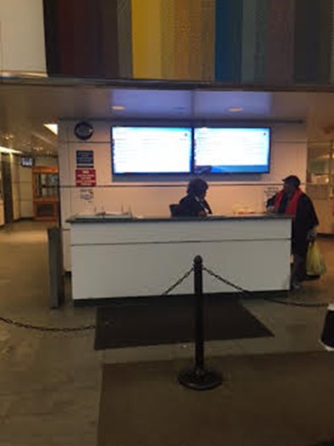
How can community members communicate with the Board of Education?
All regular board meetings start at 7:00 pm and are held in the Board of Education board room (5th floor) of the Stamford Government Center.
888 Washington Blvd, Office: 5th Floor, Stamford, CT 06901

Slide 9
How can community members communicate with the Board of Education?
Board of Education board room (5th floor) of the Stamford Government Center
Members of the public attending a Board of Education meeting. Members of the public are invited to attend all regular board meetings.
Members of the Board holding a meeting.
All regular board meetings are public meetings.

Slide 10
How can community members communicate with the Board of Education?
Time for the Public to Be Heard is included on the agenda for the regular board meeting of each month.
Community members wishing to address the Board must sign the speaker’s roster prior to the start of the public comments portion of the agenda.
Community members are allowed three minutes to address the Board.

Slide 11
How can community members communicate with the Board of Education?
Offer your comments and feedback directly to Board Members:
The Board welcomes constructive criticisms and suggestions but, nevertheless, the community must recognize that the final decisions on any problems related to the operation of the school system are up to the Board
of Education which has been charged with that responsibility.
You may contact any individual Board Member by email, address, phone
or by sending correspondence to:
Stamford Board of Education Government Center 888 Washington Blvd Office: 5th Floor Stamford, CT 06901

Slide 12
How can community members communicate with the Board of Education?
Offer you comments and feedback directly to Board Members:
Mr. David Mannis, President Mrs. Betsy Allyn, Vice President Mr. Mike Altamura, Secretary
(203) 406-7339 (203) 964-7429 (203) 406-7339
dmannis@StamfordCT.gov ballyn@StamfordCT.gov maltamura@StamfordCT.gov
Mr. Nicola Tarzia, Assistant Secretary Mr. Frank Cerasoli Mrs. Jennienne Burke
(203) 962-5600 (203) 595-9383 (203) 595-8340
ntarzia@StamfordCT.gov fcerasoli@StamfordCT.gov jburke@StamfordCT.gov
Mr. Andy George Mr. Antione Savage Mrs. Jackie Heftman
(203) 322-3511 (203) 969-4319 (203) 329-8108
ageorge@StamfordCT.gov asavage@StamfordCT.gov jheftman@StamfordCT.gov

Slide 13
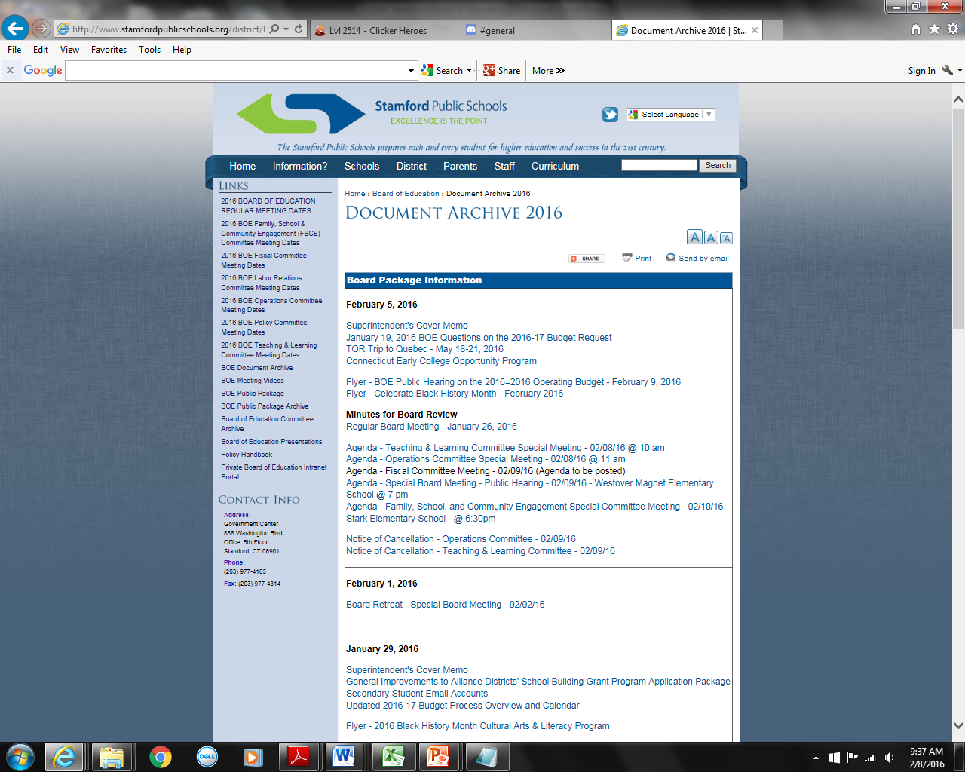
How can I find more information about the Stamford Board of Education?
Each Friday all public documents related to the upcoming meetings are posted on the Stamford Public Schools Website.
Additionally, you can find the following Board of Education information on the Stamford Public Schools Website:
General Board of Education and Committee Meeting Agendas.
Board and Committee Meeting Minutes.
Board and Committee Meeting Dates
Recordings of video and audio files of public Board meetings.
www.stamfordpublicschools.org

